Slide 1
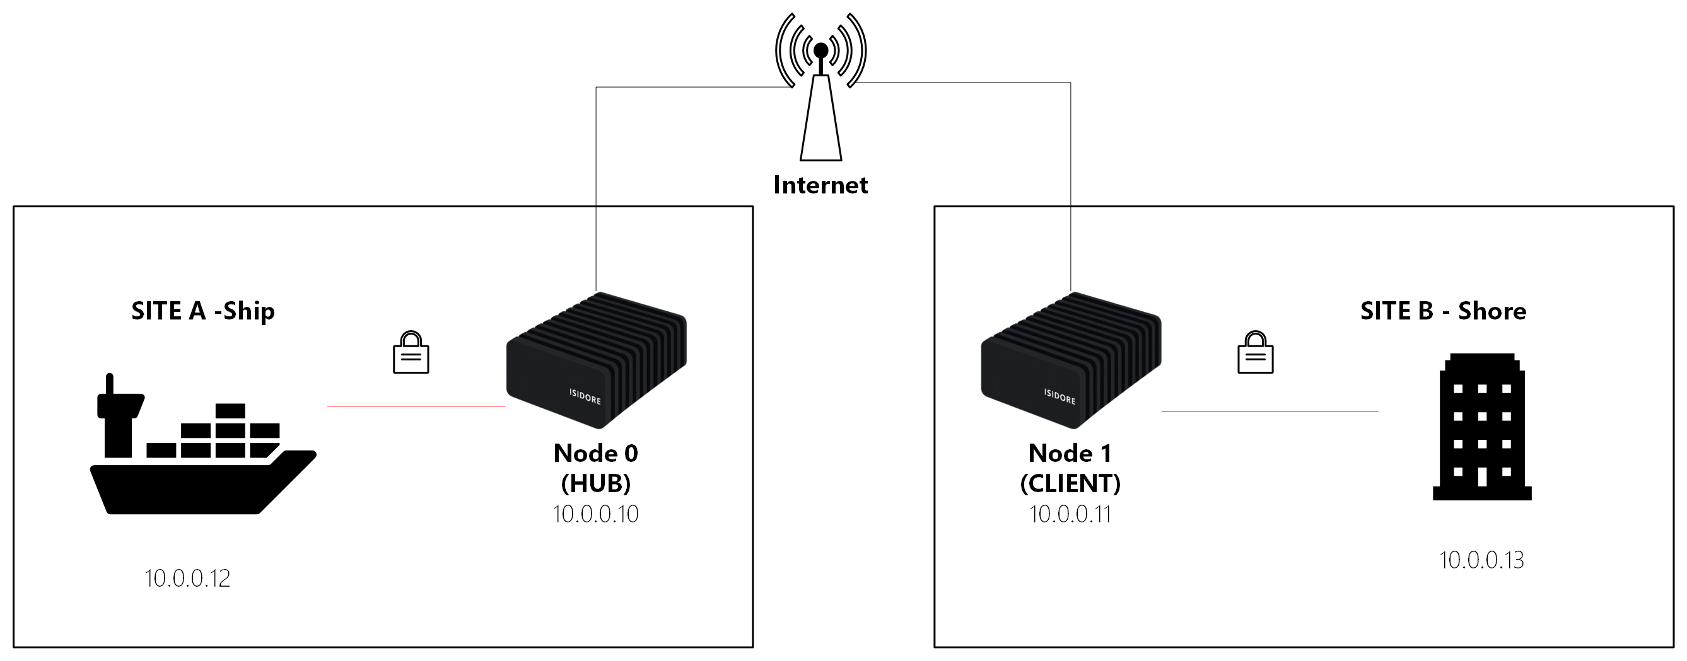
UNCLASSIFIED
(U) Quantum-Safe Maritime Cybersecurity - Isidore Quantum®
(U) Description: Validate post-quantum encryption platform for naval operations across various communications systems.
(U) Objective: Demonstrate and validate a quantum-resilient cybersecurity and communication architecture in an operational naval environment, showcasing resilience against future quantum-enabled adversaries.
(U) Availability date: Q2 2026 for exercise execution in JUN 2026
(U) Program risks / impact: Minimal - drop-in design, autonomous post-deployment. Early validation supports Navy modernization priorities.
(U) Geographical domain: Maritime, ship to shore (vessels, ports, comms links)
(U) Recommended host unit: PACFLT operational assets
(U) Experimentation sponsor: United States Pacific Fleet (PACFLT). Supporting: USINDOPACOM J81 JEESC, NAVAIR
(U) Funding status:
Forward Edge-AI (Self) funded
(U) POC:
Brandon Chapman -
Brandon@forwardedge.ai
UNCLASSIFIED

Slide 2
UNCLASSIFIED
(U) Quantum-Safe Maritime Cybersecurity - Isidore Quantum®
(U) Personnel / equipment list: Forward Edge-AI integration team (2-3), Naval IT personnel (4-5), Observers (1-2). Isidore Quantum units(4-6) are available to support various operations as needed. Forward Ege-AI will bring: 8-port switch(1), Laptops(2), Ethernet cables, and 5-volt PSUs(4).
(U) Exercise considerations: Isidore Quantum is FIPS 140-3 compliant and can operate on any network but is not currently high assurance certified. Minimal integration concerns.
(U) Required Exercise events: Operational vessel underway, shore operations; communication exercises.
Deployment: 2+ operational naval vessels, one shore facility, one comms gateway.
One Isidore unit and one FEAI team member will be located at the first site and one Isidore unit and one FEAI team member will be located at another.
Other Concerns: None
(U) Host component / unit support requested: Communications equipment access across ship and shore assets, observers (cybersecurity SMEs, command staff, and logistics personnel)
Logistics support required: Power, network accessibility, and network integration support. Standard outlets for power,
UNCLASSIFIED

